Slide 1








Presented by : Team Hackerz
Date : 22-10-2023
SARATHI
HS Sagar vasishta
Harish kumawat
SAFETY ASSISTED
RESPONSIVE AUTOMATED
TECH FOR HIGHWAY INDEPENDENCE
Neha R
Jayanth SD

Slide 2

SAFETY ASSISTED RESPONSIVE AUTOMATED TECH FOR HIGHWAY INDEPENDENCE - S.A.R.A.T.H.I
Slide - 1
Introduction - Idea Overview
Safety Assisted Responsive Automated Tech for Highway Independence is a groundbreaking project designed to address the critical issue of safety on highways.
Idea :
> SARATHI aims to enhance driver safety and independence on highways by providing real-time assistance,
the system is platform independent, and can be easily deployed into any ARM powered system.
> SARATHI's primary goal is to address these safety challenges by providing real-time drowsiness detection
and driver assistance, making highways safer for all.
SARATHI intends to make highways safer, it can be easily plugged into heavy or light vehicles with just
a pocket sized device
> About SARA :At the core of SARATHI is SARA (Safety Assisted Responsive Assistant), an intelligent voice assistant designed to assist drivers in real time.
SARA is the voice-driven virtual assistant that connects users to the SARATHI system, providing real-time assistance and guidance.

Slide 3
SAFETY ASSISTED RESPONSIVE AUTOMATED TECH FOR HIGHWAY INDEPENDENCE - S.A.R.A.T.H.I
Slide - 2
Problem Statement
Safety Challenges on Highways: Highways pose unique safety challenges, including driver fatigue, drowsiness, and a higher likelihood of accidents.
Drowsy driving is a leading contributor to accidents and fatalities, making it a critical issue to address.
Alarming statistics on road accidents emphasize the urgent need for innovative solutions.
There's a growing demand for technology-driven driver assistance systems to improve highway safety.

Slide 4
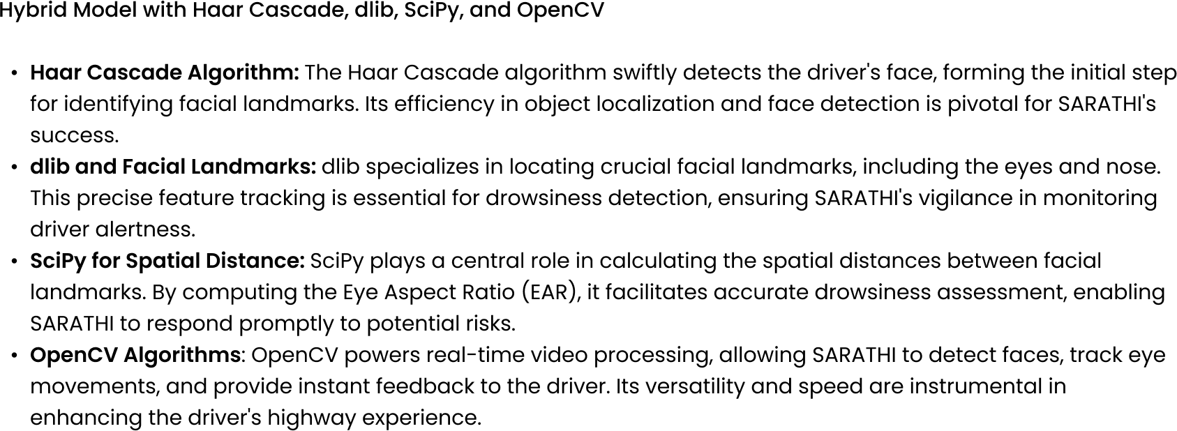
SAFETY ASSISTED RESPONSIVE AUTOMATED TECH FOR HIGHWAY INDEPENDENCE - S.A.R.A.T.H.I
Slide - 3
Technical Overview - 1 - Building a Hybrid Model

Slide 5
SAFETY ASSISTED RESPONSIVE AUTOMATED TECH FOR HIGHWAY INDEPENDENCE - S.A.R.A.T.H.I
Slide - 4
Technical Overview - 2 - SARA, Your Responsive Assistant
SARA, Your Safety Assisted Responsive Assistant:
S.A.R.A, short for Safety Assisted Responsive Assistant, designed to provide real-time assistance to drivers.
With the capability to recognize the wake word "hey SARA", SARA swiftly responds to user commands, acting as the bridge between the driver and SARATHI. Through the integration of natural language processing, speech recognition, and text-to-speech synthesis, SARA ensures a responsive and intuitive communication channel for drivers.
Porcupine Voice Recognition: Porcupine enables SARATHI's swift response by recognizing specific wake words, such as "hey SARA," serving as triggers for user interaction.
Natural Language Processing (NLP): NLP empowers SARATHI to understand and process the user's spoken commands, allowing it to generate appropriate responses, making SARATHI a user-friendly and intelligent voice assistant.

Slide 6
SAFETY ASSISTED RESPONSIVE AUTOMATED TECH FOR HIGHWAY INDEPENDENCE - S.A.R.A.T.H.I
Slide - 5
Market Prospects - Enhancing Highway Safety
Market Research Insights:
The global market for automotive safety systems is projected to reach $152.5 billion by 2026, at a CAGR of 11.7% from 2021 to 2026.
In the United States alone, there were approximately 33,000 fatal motor vehicle crashes in 2023, with an economic cost of over $240 billion.
According to a recent survey, over 60% of drivers have experienced drowsy driving at least once in their lives.
SARATHI's Position in the Market:
SARATHI is uniquely positioned to tap into the growing market for safety-assisted highway driving.
By offering a comprehensive solution that addresses drowsy driving and enhances driver alertness, SARATHI aligns perfectly with the increasing demand for ADAS, contributing to safer highways and reduced accidents.

Slide 7
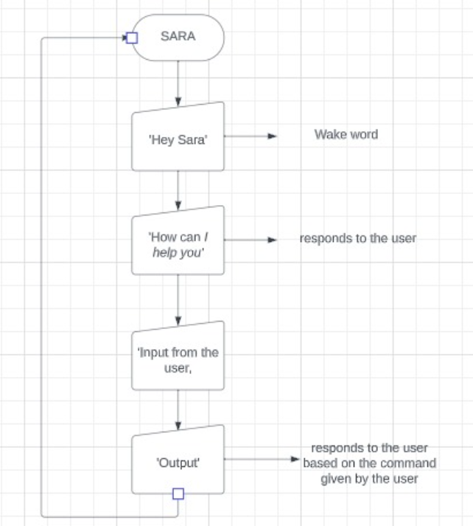
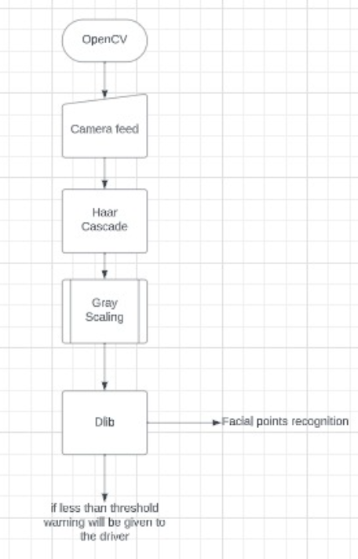
SAFETY ASSISTED RESPONSIVE AUTOMATED TECH FOR HIGHWAY INDEPENDENCE - S.A.R.A.T.H.I
Slide - 6
Execution

Slide 8
SAFETY ASSISTED RESPONSIVE AUTOMATED TECH FOR HIGHWAY INDEPENDENCE - S.A.R.A.T.H.I
Slide - 6
Future Scope
Enhancements and Expansions: SARATHI is poised for exciting future developments. Our team envisions several areas of enhancement:
Real-time GPS Integration: Integrating real-time GPS data opens opportunities for location-based assistance, navigation, and traffic analysis.
Vehicle Control Features: Expanding SARATHI's capabilities to control vehicle functions, such as lights and air conditioning, offers added convenience and safety.
Integration with IoT Devices: We're exploring partnerships with IoT devices to provide comprehensive and real-time safety information, further enhancing highway safety.
Potential for Autonomous Driving: As autonomous driving technology advances, SARATHI's role could evolve to become an integral part of self-driving vehicles, ensuring safe transitions from manual to autonomous modes.
Expanding Languages and Dialects: SARA's influence can extend globally with support for multiple languages and dialects, making it accessible and relevant across diverse regions.

Slide 9
SAFETY ASSISTED RESPONSIVE AUTOMATED TECH FOR HIGHWAY INDEPENDENCE - S.A.R.A.T.H.I
Slide - 7
Conclusion -For a Safer Tomorrow
Transforming Highway Safety: SARATHI, our endeavor in Safety Assisted Responsive Automated Tech for Highway Independence, marks a significant stride toward safer highways. At its core, SARA, the Safety Assisted Responsive Assistant, has proven itself invaluable.
Achievements and Gratitude: We celebrate the accomplishments along this journey, from reducing accidents to empowering drivers with advanced assistance. Our heartfelt thanks go out to the dedicated team, contributors, and supporters who have shaped this vision.
Stay Connected: We invite you to connect with us, share ideas, and explore potential collaborations. Together, we can continue to drive innovation and create a safer, more independent highway experience.
A Brighter Road Ahead: As we conclude, remember that SARATHI signifies the commitment to a future where highways are safer, driving is more independent, and technology keeps us vigilant. The path forward holds great promise, and we are excited to journey together.

Slide 10
SAFETY ASSISTED RESPONSIVE AUTOMATED TECH FOR HIGHWAY INDEPENDENCE - S.A.R.A.T.H.I
Slide - 7
"In the journey to safer highways, the most crucial road is the one we pave together. Thank you for joining us on this path to a safer and more independent future on the road. Your support fuels our commitment to make a difference."
The SARATHI Team

